Slide 1


LINEAR DATA STRUCTURE
QUEUE
CO1: Classify and Apply the concepts of stacks, queues and linked list in real life problem solving
Reference:
1. Reema Thareja; Data Structures using C; Oxford
2. Ellis Horowitz, Sartaj Sahni; Fundamentals of Data Structures; Galgotia Publications
3. Jean Paul Tremblay, Paul G. Sorenson; An introduction to data structures with applications; Tata McGrawHill

Slide 2

QUEUE
Introduction of queue
Array implementation of queue
Types of queue
Circular queue
Double ended queue
Priority queue
Applications of queue

Slide 3


INTRODUCTION OF QUEUE
Queue is a linear data structure which follows First In First Out (FIFO) principle
Queue is a linear list of elements of same type in which insertion of an element is performed at one end and deletion of an element is performed at another end
Insertion can take place only at one end which is called as Rear
Deletion can take place only at one end which is called as Front
Example:
Queue of car on one way road
Queue of People waiting to purchase tickets

Slide 4
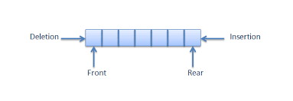
QUEUE OPERATIONS
Queue operations:
Enqueue: To insert an element to the rear of a queue
Dequeue: To delete an element from the front of a queue
Queue empty: To check whether queue is empty
Queue full: To check whether queue is full
Get front: To get first element from the front of a queue
Get rear: To get last element from the rear of a queue

Slide 5
ARRAY IMPLEMENTATION OF QUEUE
Example:
Insert 10, 20,23,5,11,45,60 into a queue, delete two elements from a queue, insert 90,55,78 in a queue and get front and rear element of a queue and check queue is full or not.
0 | 1 | 2 | 3 | 4 | 5 | 6 | 7 | 8 | 9
10
20
23
5
11
45
60
90
55
78
Front = -1
Rear = -1
Front = 0
Front = 1
Front = 2
Rear = 0
Rear = 1
Rear = 2
Rear = 3
Rear = 4
Rear = 5
Rear = 6
Rear =7
Rear =8
Rear = 9
Insert 10
Delete 10
Queue Full
True
Insert 20
Delete 20
Insert 23
Insert 90
Insert 5
Insert 55
Insert 11
Insert 78
Insert 45
Get Front
23
Insert 60
Get Rear
78

Slide 6
ARRAY IMPLEMENTATION OF QUEUE
0 | 1 | 2 | 3 | 4 | 5 | 6 | 7 | 8 | 9
10
20
23
5
11
45
60
90
55
78
Front = -1
Rear = -1
Front = 0
Rear = 0
Rear = 1
Rear = 2
Rear = 3
Rear = 4
Rear = 5
Rear = 6
Rear =7
Rear =8
Rear = 9
Queue empty: To check whether queue is empty
bool isEmpty(int queue[ ])
{
if(front == rear == -1)
return true;
else
return false;
}
Queue full: To check whether queue is full
bool isFull(int queue[ ])
{
if(rear = = (MAX-1))
return true;
else
return false;
}

Slide 7
ARRAY IMPLEMENTATION OF QUEUE
Enqueue: To insert data to the rear of a queue
void enqueue(int data)
{
if(rear = = (MAX-1))
printf(“Queue is full ! Overflow !!”);
else if(front == -1 && rear == -1)
{
front = rear = 0;
queue[rear] = data;
}
else
{
rear++;
queue[rear] = data;
}
}
0 | 1 | 2 | 3 | 4 | 5 | 6 | 7 | 8 | 9
10
20
23
5
Front = -1
Rear = -1
Front = 0
Rear = 0
Rear = 1
Rear = 2
Rear = 3

Slide 8
ARRAY IMPLEMENTATION OF QUEUE
Dequeue: To delete data from the front of a queue
int dequeue()
{
int data;
if(front == rear== -1)
printf(“Queue is Empty ! Underflow !!”);
else if(front == rear)
{
data = queue[front];
front = rear = -1;
return data;
}
else
{
data = queue[front]
front++;
return data;
}
}
0 | 1 | 2 | 3 | 4 | 5 | 6 | 7 | 8 | 9
10
20
23
5
Front = -1
Rear = -1
Front = 0
Front = 1
Front = 2
Front = 3
Rear = 3
data =5
data =23
data =20
data =10

Slide 9
ARRAY IMPLEMENTATION OF QUEUE
0 | 1 | 2 | 3 | 4 | 5 | 6 | 7 | 8 | 9
10
20
23
5
Front = -1
Rear = -1
Front = 0
Rear = 0
Rear = 1
Rear = 2
Rear = 3
Get Front: To get the front element of a queue
int getFront()
{
if(front == rear == -1)
printf(“Queue is Empty ! Underflow !!”);
else
return queue[front];
}
Get Rear: To get the rear element of a queue
int getRear()
{
if(front == rear == -1)
printf(“Queue is Empty ! Underflow !!”);
else
return queue[rear];
}

Slide 10
QUEUE - QUESTION FOR PRACTICE
Question 1:
Draw the queue structure in each case when the following operations are performed on an empty queue
(a) Add A, B, C, D, E, F
(b) Delete two letters
(c) Add G
(d) Add H
(e) Delete four letters
(f) Add I

Slide 11
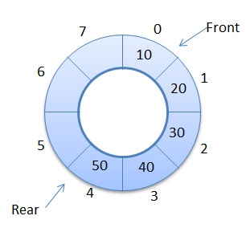
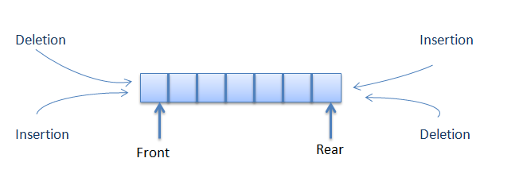
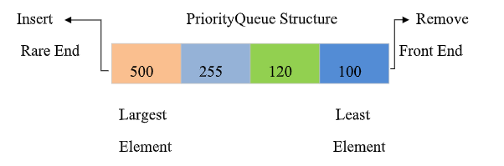
TYPES OF QUEUES
Circular Queue
Double Ended Queue
Priority Queue

Slide 12
CIRCULAR QUEUE
Need of Circular Queue:
Insert 10, 20,30,40,50,45,60 into a queue, delete two elements from a queue, insert 90 in a queue and get front and rear element of a queue and check queue is full or not.
Drawbacks of Queue:
We need to write a suitable code to make the front regularly catch up with the rear and reset both and array implementation of linear queues leads to the QueueFull state even though the queue is not actually full
Solution 1: Shift the elements to the left so that vacant space can be occupied and utilized efficiently, This is time consuming if queue is large
Solution 2: When QueueFull is signalled, we can wraparound queue upon reaching the end of the array eliminates this drawbacks. Such a technique which allows the queues to wraparound from end to start is called a circular queue.
0 | 1 | 2 | 3 | 4 | 5 | 6 | 7
10
20
30
40
50
45
60
90
Front = -1
Rear = -1
Front = 0
Front = 1
Front = 2
Rear = 0
Rear = 1
Rear = 2
Rear = 3
Rear = 4
Rear = 5
Rear = 6
Rear =7

Slide 13
CIRCULAR QUEUE
0 | 1 | 2 | 3 | 4 | 5 | 6 | 7
10
20
30
40
50
45
60
90
Front = -1
Rear = -1
Front = 0
Front = 1
Front = 2
Rear = 0
Rear = 1
Rear = 2
Rear = 3
Rear = 4
Rear = 5
Rear = 6
Rear =7
How to make Circular way:
When rear = MAX-1 and there are empty spaces at the start of the queue, then to reach the start of the queue we can use -
rear = (rear+1)%MAX
Example: rear = 7 and MAX = 8
rear = (7+1)%8 = 0
So, rear = 0

Slide 14
ARRAY IMPLEMENTATION OF CIRCULAR QUEUE
Circular Queue Operations:
0 | 1 | 2 | 3 | 4 | 5 | 6 | 7
15
42
30
40
50
45
60
90
rear = (rear+1)%MAX
Front = 2
rear =0
rear =1
Rear =7
rear = 7 and MAX = 8
rear = (7+1)%8 = 0
So, rear = 0
rear = 0 and MAX = 8
rear = (0+1)%8 = 1
So, rear = 1
rear = 1 and MAX = 8
rear = (1+1)%8 = 2
So, rear = 2
Circular Queue Full: To check whether queue is Full
bool isFull(int cqueue[ ])
{
if(((rear+1)%MAX) == front)
return true;
else
return false;
}
Circular Queue empty: To check whether queue is empty
bool isEmpty(int cqueue[ ])
{
if(front == rear == -1)
return true;
else
return false;
}

Slide 15
ARRAY IMPLEMENTATION OF CIRCULAR QUEUE
Enqueue: To insert an element in a circular queue
void enqueue(int cqueue[ ], int data)
{
{
}
else
{
}
}
if(front == rear == -1)
front = rear = 0;
0 | 1 | 2 | 3 | 4 | 5 | 6 | 7
cqueue[rear] = data;
5
24
53
else if(((rear+1)%MAX) == front)
front = -1
rear = -1
front = 0
printf(“\n Queue is Full !!”)
rear = 0
rear = 1
rear = 2
rear = 1 and MAX = 8
rear = (1+1)%8 = 2
So, rear = 2
data =24
rear = 0 and MAX = 8
rear = (0+1)%8 = 1
So, rear = 1
data =5
rear = ((rear+1)%MAX)
data =53
cqueue[rear] = data;

Slide 16
ARRAY IMPLEMENTATION OF CIRCULAR QUEUE
Dequeue: To delete an element from a circular queue
void dequeue(int cqueue[ ])
{
{
}
else
{
}
}
if(front == rear == -1)
printf(“\n Queue is Empty !!”)
else if(rear == front)
0 | 1 | 2 | 3 | 4 | 5 | 6 | 7
5
24
53
printf(“%d”, cqueue[front]);
front = rear =-1
front = -1
rear = -1
front = 0
front = 1
front = 2
rear = 2
printf(“%d”, cqueue[front]);
5
24
53
front = 0 and MAX = 8
front = (0+1)%8 = 1
So, front = 1
front = ((front+1)%MAX);
front = 1 and MAX = 8
front = (1+1)%8 = 2
So, front = 2

Slide 17
CIRCULAR QUEUE - QUESTION FOR PRACTICE
Question 2:
Draw the Circular queue with structure in each case when the following operations are performed on an empty queue with MAX = 7
1. enqueue(1), enqueue(2), enqueue(3), enqueue(4), enqueue(5), enqueue(6)
2. dequeue(), dequeue()
3. enqueue(7), enqueue(8), enqueue(9)
4. dequeue()
5. write if circular queue is full or not.

Slide 18
DOUBLE ENDED QUEUE
A deque is a linear list in which elements can be inserted and deleted at either end
Deque supports properties of stack and queue (It can be used as stack as well as queue)

Slide 19
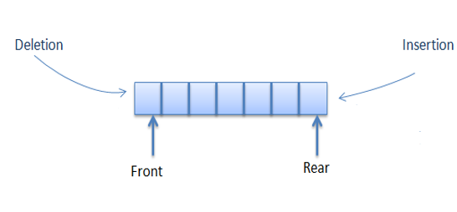
DOUBLE ENDED QUEUE
A deque is a linear list in which elements can be inserted and deleted at either end
Deque supports properties of stack and queue (It can be used as stack as well as queue)
Deque as a queue
Deque as a Stack

Slide 20
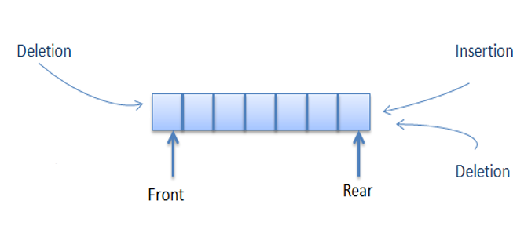
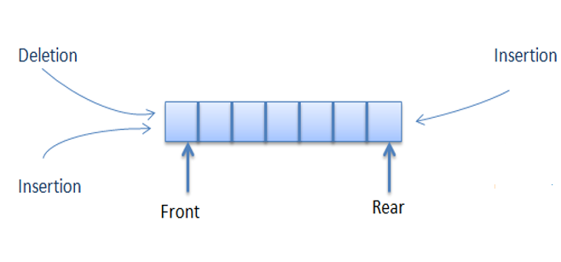
TYPES OF DEQUE
Input Restricted Deque: Insertion is allowed only at one end and deletion from both ends
Output Restricted Deque: Deletion is allowed only at one end and insertion at both ends
Input Restricted Deque
Output Restricted Deque

Slide 21
DEQUE OPERATIONS
Deque Operations:
Insert at front: perform front --
Insert at rear: perform rear ++
Delete from front: perform front ++
Delete from rear: perform rear --
Get front:
Get rear:
Deque Empty:
Deque Full:
Example:
Insert 10, 20,23 at rear, delete from front, insert at front 5,11,45, delete from front twice, delete from rear and get front and rear element of a dequeue and check if queue is full.
0 | 1 | 2 | 3 | 4 | 5 | 6 | 7
10
20
23
45
11
5
Front = -1
Rear = -1
Front = 0
Front = 1
Front = 6
Front = 7
Rear = 0
Rear = 1
Rear = 2
MAX = 8
Insert at rear 10
Insert at front 5
Delete from front
Insert at rear 20
Insert at front 11
Delete from rear
Insert at rear 23
Insert at front 45
Get front
5
Delete from front
Delete from front
Get rear
20

Slide 22
DEQUE OPERATIONS USING CIRCULAR ARRAY
Insert at front:
Void enqueuefront(int dq[ ], int data)
{
printf(“\n Deque is full !!”);
else
}
Example:
Insert 10, 25, 40 at front
if(front == 0 && rear == MAX-1) || ( front == rear+1)
else if(front == -1 && rear == -1)
0 | 1 | 2 | 3 | 4 | 5 | 6 | 7
front = rear = 0;
else if(front == 0)
10
40
25
front = MAX-1;
Front = -1
Rear = -1
Front = 0
Front = 6
Front = 7
front--;
Rear = 0
dq[front] = data;
MAX = 8
Data = 10
Data = 40
Data = 25

Slide 23
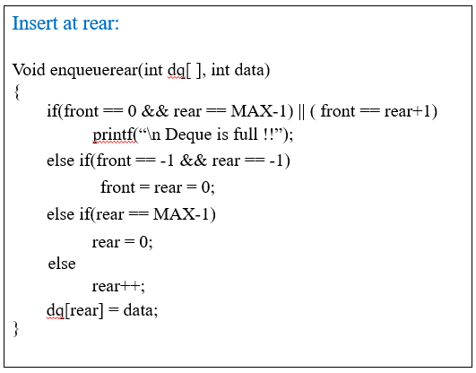
DEQUE OPERATIONS USING CIRCULAR ARRAY
Insertion of data at rear :
Example:
Insert 10, 25, 40, 98 at rear
0 | 1 | 2 | 3 | 4 | 5 | 6 | 7
98
55
12
24
48
40
10
25
43
Front = -1
Rear = -1
Front = 0
Front = 1
Rear = 0
Rear = 1
Rear = 6
Rear = 7
MAX = 8
Data = 10
Data = 25
Data = 40
Data = 98

Slide 24
DEQUE OPERATIONS USING CIRCULAR ARRAY
Deletion of data from front :
void dequeuefront(int dq[ ])
{
if(front == rear == -1)
printf(“\n Deque is Empty !!”);
else if( front == rear)
{
printf(“\n dq[front] = %d”, dq[front]);
front = rear = -1;
}
else if(front == MAX-1)
{
printf(“\n dq[front] = %d”, dq[front]);
front = 0;
}
else
{
printf(“\n dq[front] = %d”, dq[front]);
front++;
}
}
Example:
Delete 24, 48, 40, 98 from front
0 | 1 | 2 | 3 | 4 | 5 | 6 | 7
98
24
48
40
Front = -1
Rear = -1
Front = 0
Front = 5
Front = 6
Front = 7
Rear = 0
MAX = 8
dq[front] = 98
dq[front] = 24
dq[front] = 48
dq[front] = 40

Slide 25
DEQUE OPERATIONS USING CIRCULAR ARRAY
Deletion of data from Rear :
void dequeuerear(int dq[ ])
{
if(front == rear == -1)
printf(“\n Deque is Empty !!”);
else if( front == rear)
{
printf(“\n dq[rear] = %d”, dq[rear]);
front = rear = -1;
}
else if(rear == 0)
{
printf(“\n dq[rear] = %d”, dq[rear]);
rear = MAX-1;
}
else
{
printf(“\n dq[rear] = %d”, dq[rear]);
rear--;
}
}
Example:
Delete 24, 48, 98, 40 from rear
0 | 1 | 2 | 3 | 4 | 5 | 6 | 7
98
48
24
40
Front = -1
Rear = -1
Front = 7
Rear = 0
Rear = 1
Rear = 2
Rear = 7
MAX = 8
dq[rear] = 40
dq[rear] = 98
dq[rear] = 48
dq[rear] = 24

Slide 26
DEQUE OPERATIONS USING CIRCULAR ARRAY
0 | 1 | 2 | 3 | 4 | 5 | 6 | 7
98
48
24
40
MAX = 8
Front = 7
Rear = 2
Get front:
void getfront(int dq[ ])
{
if (front == rear == -1)
printf(“\n Deque is Empty”);
else
printf(“dq[front]: %d”, dq[front]);
}
Get rear:
void getrear(int dq[ ])
{
if (front == rear == -1)
printf(“\n Deque is Empty”);
else
printf(“dq[rear]: %d”, dq[rear]);
}

Slide 27
DEQUE – QUESTION FOR PRACTICE
Question:
Perform following options on following double ended queue
Enqueue 10 at front
Enqueue 20 at front
Enqueue 30 at rear
Dequeue from front
Enqueue 22 at rear
Dequeue from rear
Dequeue from front
0 | 1 | 2 | 3 | 4 | 5 | 6
 | 23 | 4 | 78 | 90
Front = 1
Rear = 4

Slide 28
PRIORITY QUEUE
A priority queue is a special type of queue in which each element is associated with a priority and is served according to its priority
The general rules of processing the elements of a priority queue are
An element with higher priority is processed before an element with a lower priority
Two elements with the same priority are processed on a first-come-first-served (FCFS) basis

Slide 29
PRIORITY QUEUE
There are two ways to implement a priority queue –
Sorted list - While inserting an element it is inserted at its appropriate place according to priority
Advantage - Deletion is easy; elements are stored by priority, so just delete from the beginning of the list
Disadvantage - Insertion is hard; it is necessary to find the proper location for insertion
A linked list is convenient for this implementation
Data | 90 | 78 | 45 | 50 | 65
Priority | 4 | 3 | 2 | 2 | 1
Front
Rear
Data | 90 | 78 | 25 | 45 | 50 | 65
Priority | 4 | 3 | 3 | 2 | 2 | 1
Front
Rear

Slide 30
PRIORITY QUEUE
There are two ways to implement a priority queue –
Unsorted list - While inserting an element it is inserted at the end of the queue
Advantage - Insertion is easy; just add elements at the end of the list.
Disadvantage - Deletion is hard; it is necessary to find the highest priority element first.
An array is convenient for this implementation
Data | 90 | 65 | 45 | 78 | 50
Priority | 4 | 1 | 2 | 3 | 2
Front
Rear
Data | 90 | 65 | 45 | 78 | 50 | 25
Priority | 4 | 1 | 2 | 3 | 2 | 3
Front
Rear

Slide 31
ARRAY IMPLEMENTATION OF PRIORITY QUEUE
Operations performed on Priority Queue:
Enqueue: To insert an element at the rear end in the priority queue at the rear end
Dequeue: To delete an element with highest priority from queue
Queue empty: To check whether queue is empty
Queue full: To check whether queue is full
Structure definition –
typedef struct
{
int Data;
int priority;
int order;
}Pqueue;

Slide 32
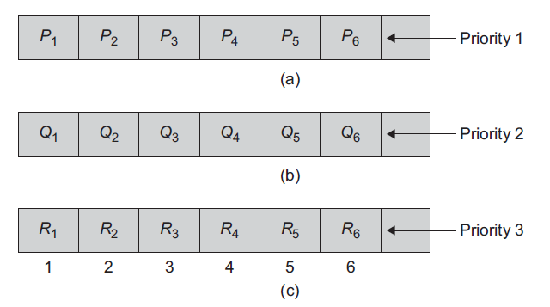
PRIORITY QUEUE
Example:
A list of patients in an emergency room; each patient might be given a ranking that depends on the severity of the patient’s illness
Applications of Priority Queue:
Priority queues are used for implementing job scheduling by the operating system where jobs with higher priority are to be processed first
Priority queues can be used in simulation systems where the priority corresponds to event time

Slide 33
APPLICATIONS OF QUEUE
Queues are widely used as waiting lists for a single shared resource like printer, disk, CPU (CPU scheduling, Disk Scheduling).
Queues are used in asynchronous transfer of data (where data is not being transferred at the same rate between two processes) for eg. pipes, file IO, sockets.
Queues are used as buffers in most of the applications like MP3 media player, CD player, etc.
Queue are used to maintain the play list in media players in order to add and remove the songs from the play-list.
A queue is used for finding a path using the breadth-first search of graphs.

Slide 34
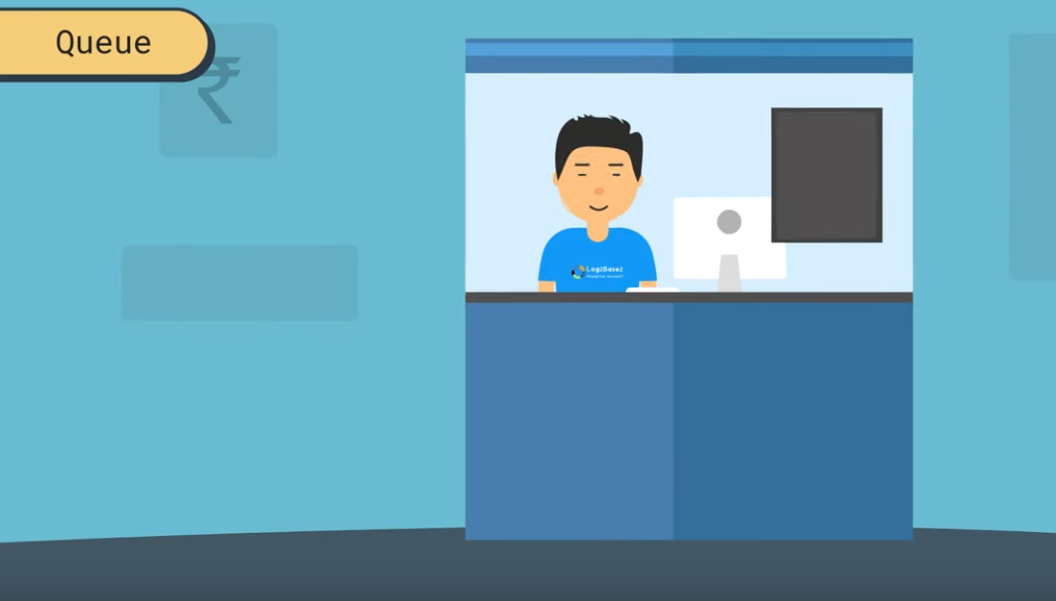



APPLICATIONS OF QUEUE
Ticket Booking Counter
Ticket 1
Ticket 2
Ticket 3

Slide 35
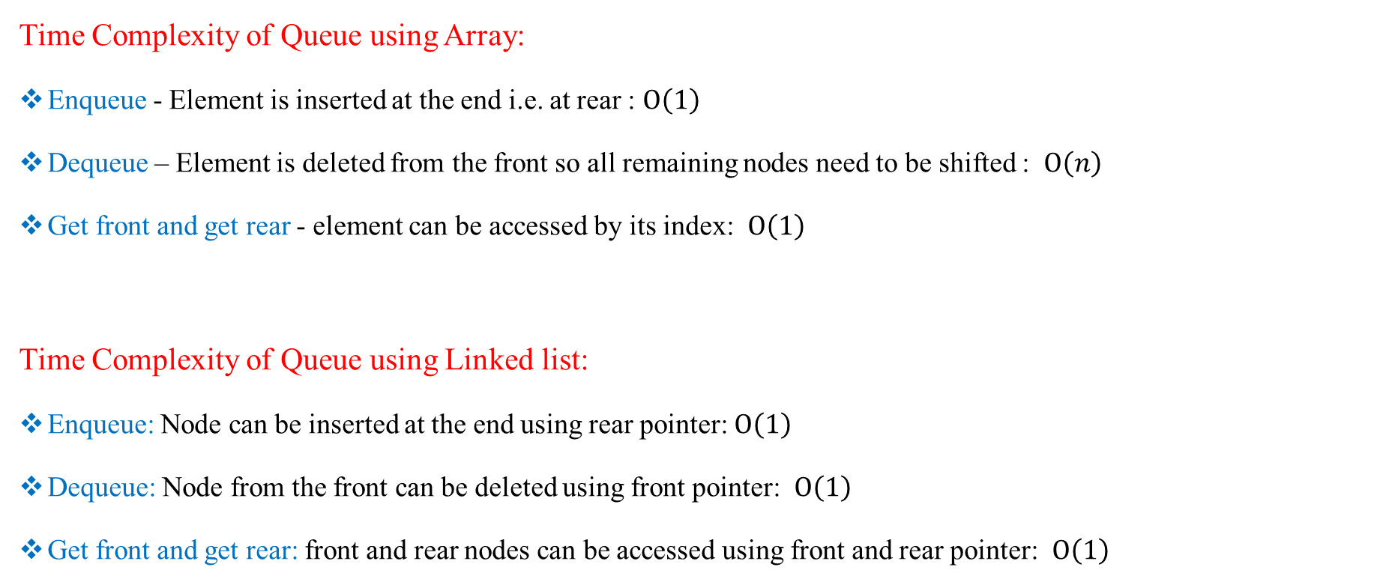
ANALYSIS OF QUEUE

